Slide 1
Computer Graphics and Image Processing

Slide 2
Agenda
Basic geometric operations on 2D and 3D objects
2 D and 3 D transformations on objects
Bresenham line drawing
Emotion recognition in real time
Face detection in an image
Program to blur and smoothen an image
Splitting a digital image into 4 quadrants
Animation

Slide 3
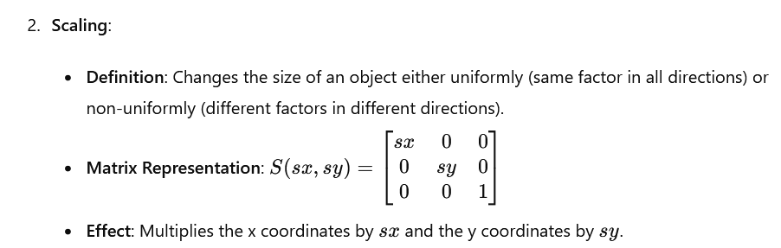
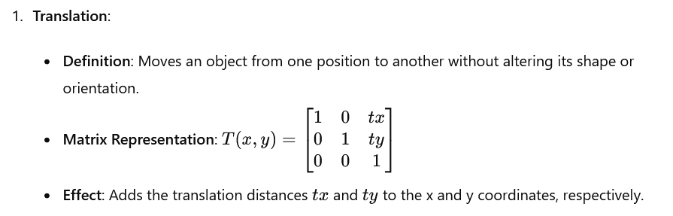
2D Transformations
2D transformations are fundamental operations in computer graphics, allowing for the manipulation of objects in a two-dimensional plane

Slide 4
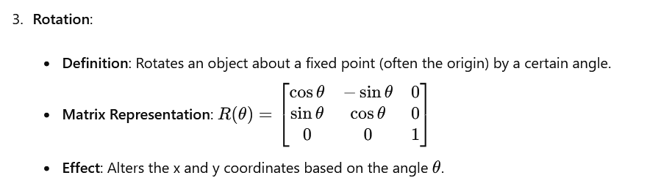
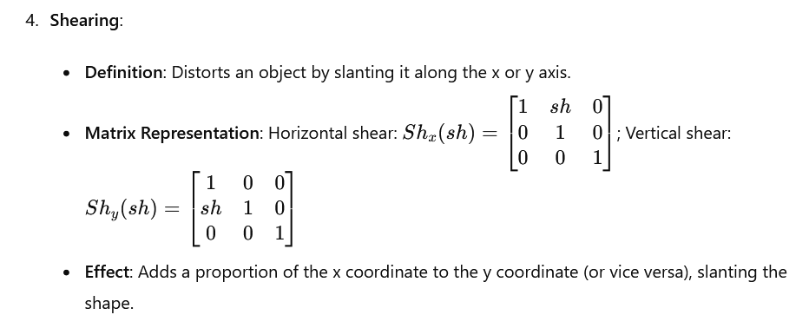
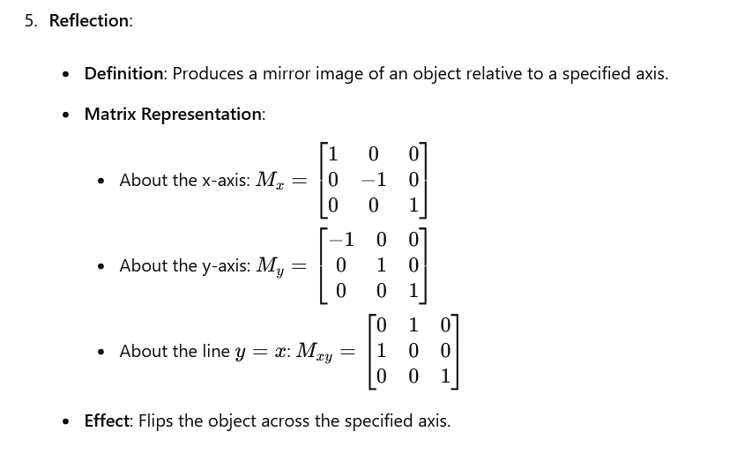

Slide 5
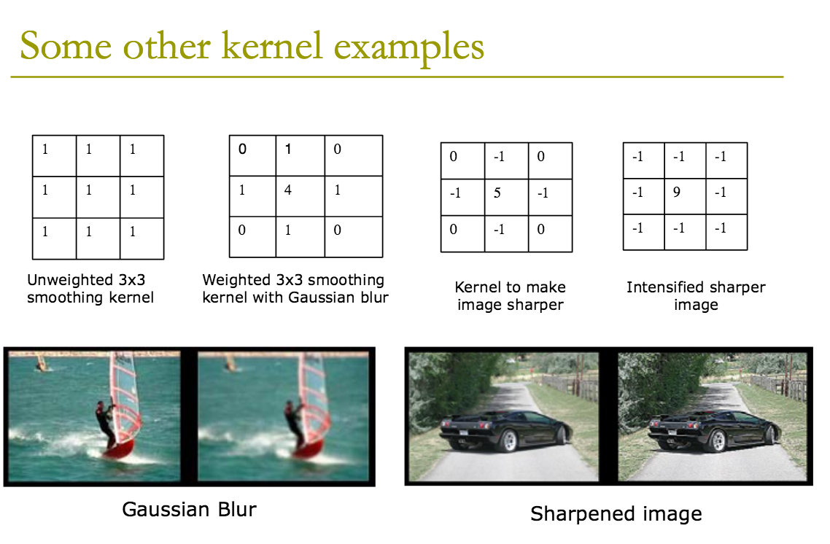

Slide 6
Bluring techniques
Blurring techniques are commonly used in image processing to reduce noise, detail, and sharpness.
The various types of blur are
Kernel Blur
Average Blur
Gaussian Blur
Median Blur
Bilateral Blur

Slide 7
Kernel Blur (Convolution Blur)
Kernel blur refers to a general process of blurring an image using a convolution operation.
A kernel (or filter) is a small matrix that is applied over each pixel and its neighbors in the image, calculating a weighted sum of the surrounding pixels.
The kernel determines the type and extent of the blur.

Slide 8
Average Blur
Average blur, also known as mean blur, uses a kernel where all the weights are equal.
For each pixel, the value is replaced with the average of the pixel values in the neighborhood defined by the kernel.
This type of blur smooths the image uniformly and can be implemented with a simple box filter.

Slide 9
Gaussian Blur
Gaussian blur uses a Gaussian function to create the kernel.
The weights in the kernel decrease according to a Gaussian distribution from the center outwards.
This results in a natural-looking blur that simulates the effect of viewing the image through a translucent screen.
Gaussian blur preserves edges better than average blur due to the gradual change in pixel values.

Slide 10
Median Blur
Median blur replaces each pixel's value with the median value of the pixels in its neighborhood.
This type of blur is particularly effective at removing salt-and-pepper noise (random bright and dark pixels) while preserving edges better than average and Gaussian blurs.
The median is determined by sorting the pixel values and selecting the middle value.

Slide 11
Bilateral Blur
Bilateral blur (or bilateral filter) is an advanced technique that smooths an image while preserving edges.
It considers both the spatial distance and the intensity difference between pixels.
A pixel's new value is a weighted average of its neighbors, where weights decrease with distance in both spatial and intensity domains.
This results in effective noise reduction without blurring edges, making it ideal for applications like denoising photographs or preparing images for edge detection.

Slide 12
Characteristics of various types of blur
Kernel Blur: General blurring technique using a convolution matrix.
Average Blur: Uniform smoothing using equal weights in the kernel.
Gaussian Blur: Natural-looking blur using a Gaussian function for weights, preserves edges moderately well.
Median Blur: Replaces pixel values with the median in the neighborhood, excellent at removing noise while preserving edges.
Bilateral Blur: Advanced filter that smooths while preserving edges by considering both spatial and intensity differences.

Slide 13
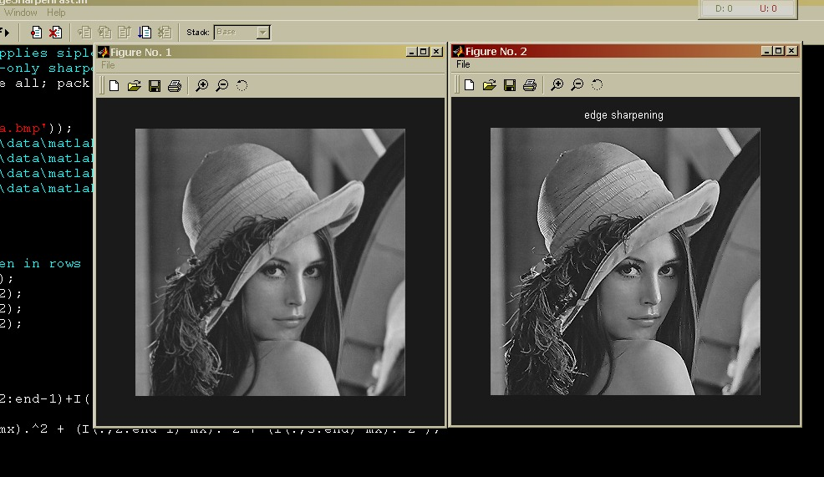
This Photo by Unknown Author is licensed under CC BY-SA

Slide 14
Edge Detection and Texture Filtering techniques
Edge detection is an essential technique in image processing and computer vision, used to identify points in an image where the brightness changes sharply or has discontinuities.
Sobel Edge Detection: The Sobel operator uses two 3x3 kernels, one for detecting horizontal edges and one for vertical edges. It emphasizes edges and transitions, particularly useful for identifying the outline of objects.
Laplacian Edge Detection: The Laplacian of Gaussian (LoG) operator first applies a Gaussian blur to smooth the image and then applies the Laplacian operator to detect edges. Useful for finding edges with a second-order derivative, and it combines both smoothing and edge detection in one process.

Slide 15
Canny Edge Detection: The Canny edge detector is a multi-stage algorithm that includes noise reduction with Gaussian blur, gradient calculation, non-maximum suppression, and hysteresis thresholding.
Provides robust edge detection and is widely used in image processing for its ability to detect true edges and reduce noise.
Steps to Apply: Apply Gaussian filter to smooth the image, Find the intensity gradients, Apply non-maximum suppression to get rid of spurious response to edge detection, Apply double threshold to determine potential edges, Track edges by hysteresis.

Slide 16
Texture Filtering Techniques
Texture filtering involves altering or enhancing the texture of an image.
Bilateral Filter: The bilateral filter smooths images while preserving edges by taking into account both spatial proximity and intensity differences. Useful for noise reduction while maintaining edge integrity, often used in preprocessing steps for further image analysis.
Gabor Filter: Gabor filters are used for texture analysis and feature extraction. They are orientation-sensitive and can be tuned to different frequencies. Used in image processing for texture representation and discrimination. It is particularly effective for recognizing patterns and textures.

Slide 17
Non-Local Means Filter: This filter replaces each pixel's value with an average of similar pixels over a larger neighborhood, based on the similarity of patches. Effective for noise reduction while preserving fine details and textures, useful in denoising applications.
Wavelet Transform: Wavelet transforms decompose an image into different frequency components, allowing for multi-resolution analysis. Useful for both texture analysis and compression. It helps in identifying features at various scales.

